Slide 1
Parts of a Data Base
12 CAT

Slide 2
There are four aspects to a data base
Tables
Forms
Queries
Reports

Slide 3
Tables
A table is the basis of a data base
It is a collection of data elements sorted into:
Rows (Records) and
Columns (Fields)
A table is also called a datasheet. A database can have many related tables
Elements in a table share records which have set fields.
Each field has a specified type e.g. Text or number etc

Slide 4
Forms
A form is a user friendly method to collect data
It has an easier environment for the beginner user.
It usually contains all the fields specified in a table

Slide 5
Queries
Queries are used to extract data from a database.
The records are extracted using criteria
Queries are saved so can be revisited many times with little or no changes to the selection criteria
We can build up a query using several tables in a data base

Slide 6
Reports
A report is a formatted, usually printable result of a table or a query.
A report can be saved in different formats e.g. pdf, csv etc
It can therefore exist outside the data base.

Slide 7
Queries in a Data Base
Gr 11 and Gr 12

Slide 8
Queries
The function of a query is to extract information from a data base.
You will seldom have to create a query but you will have to build up on an existing one.

Slide 9
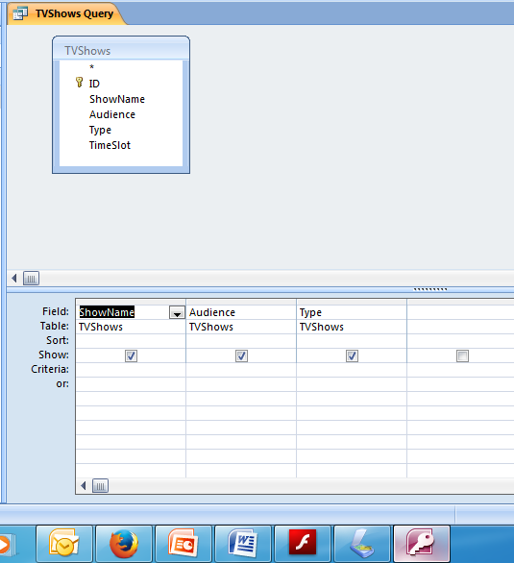
Typical Query Screen
Fields in the
Table – not all
need to be
selected for
the query
Selected fields from TV Shows table
Can do an ascending or descending sort
Can choose whether the field will be
shown
Can add Criteria

Slide 10
Criteria

Slide 11
Criteria
A criteria can be simple – one word (e.g. Comedy for Type) in which case only records that fit that word will be shown.
Using the table on the previous screen we can make the criteria tighter. E.g. under type we could use LIKE “C*” this would give us comedy as well as crime shows.

Slide 12
Criteria (2)
We can fill in more than one criteria on the criteria line. Any criteria on the criteria line will be viewed as AND. In other words a show has to fulfil both criteria in order to show.
If we fill in a criteria in the OR line records falling into either one will show.
If we use NOT that criteria will be excluded.

Slide 13
In the first example ONLY comedies for mature audiences will be displayed
In the second example ALL comedies and ALL shows for mature audiences will be displayed

Slide 14
Calculations in Queries
Grade 12 ONLY
When you are asked to do a calculation in a query you use the next available space:
In this example it is the empty field after Type

Slide 15
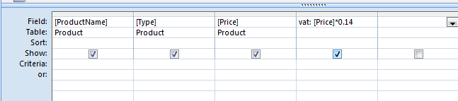
In this query you are required to calculate the vat payable on each product.
The last field in the table is Price.
Click in the next space to enter the calculation.
The calculation must have a name and refer to the field that will be used and the calculation
VAT:[Price]*0.14
The name of the new field
The Calculation
Colon NOT
Equals
The name of the field needed for the calculation – note brackets

Slide 16
Reports
12 CAT

Slide 17
Reports
Used to present data from a table or a query in printable format
The easiest way to initialise a report is to use a report wizard
Once a basic report is structured you can make changes to suit your application

Slide 18
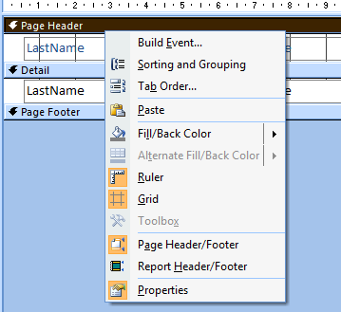
Headers and Footers
Page header and footers occur on every page of the printed report.
Report headers and footers occur at the beginning and end of the entire report.
Right click to activate each if they are not available.
Resize by dragging the bottom boundary up or down

Slide 19
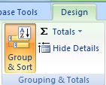
Grouping
It is possible to group data entries according to a specific field
On the design ribbon choose Group and Sort
It will display the following at the bottom of the design. Choose Add a group.

Slide 20
Grouping (2)
Once you have chosen to add a group this will display at the bottom of the design. You can then build up your groups

Slide 21
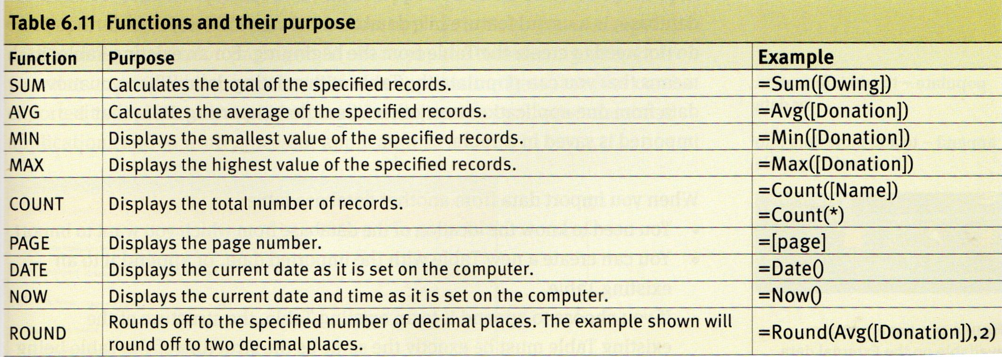
Calculations in Reports
Grade 12 ONLY
Calculations in reports start with an equal sign followed by the calculation type. The actual calculation is enclosed in round brackets. If you require a field it is enclosed in square brackets. Build them up in an inserted text box.

Slide 22
Calculations (2)
Round Brackets
= Sum([price])
Square Brackets
equals
function
field

